Slide 1
Heart Attack Possibility Prediction
Name:
Student ID:

Slide 2
Importance Of This Research
Heart attack is the most fatal chronic disease causing 25 % death all over the world. The death due to heart attack is sudden with early warnings or without any symptoms. The clinical diagnosis test of heart attack is to costly which everyone cannot prefer in undeveloped countries. The availability of experts doctor such as cardiologist is quite less in rural areas as compared to urban areas. Therefore, there was a need to develop a intelligent based heart attack possibility prediction system which can help in early detection of disease. This will help to reduce the harm caused due to heart attack.

Slide 3
Introduction
Conventional methods to diagnose takes more time such as angiography or ECG which may prove fatal and is not that useful for early prediction. To overcome the disadvantage of conventional methods for the prediction of heart attack, researchers attempted to develop smart healthcare system using machine learning techniques. Machine learning is a part of artificial intelligence, in which machine is trained on the data that is collected from patient medical history. The development of this technique has led to decrease the number of death due to heart attack.

Slide 4
Factors Affecting Heart Attack
High Blood Cholesterol
High Blood Pressure
Obesity
Stress
Lack Of Physical Activity
Drinking Alcohol
Smoking
Diabetes

Slide 5
Aim And Objectives
The aim is to classify the patient have the chances of heart attack or not. The main objective of thesis is to make prototype of heart attack prediction system that would make intelligent medical decision which traditional techniques cannot. Moreover, it would reduce the cost of medical tests and also help to learn the hidden knowledge present in historical medical dataset.

Slide 6
DATA DESCRIPTION
Features | Values
Age | It is continuous data
Sex | 1 – Male 0 - Female
Chest pain | 0 - typical angina 1 - atypical angina 2 - non-anginal pain 3 - asymptomatic
Resting blood pressure | It is continuous value measured in mm Hg
Cholesterol level | It is continuous value measured in mg/dl
Fasting blood sugar | It is continuous value measured in mg/dl
Resting electrocardiographic results | 0 – Normal 1 - ST-T wave abnormality 2 - definite left ventricular hypertrophy
Maximum heart rate achieved | It is continuous value
Exercise induced angina | 1 – Yes 0 - No
ST depression induced by exercise | It is continuous value
Slope of the peak exercise ST segment | 0 – up sloping 1 – flat 2 – down sloping
Number of major vessels | It is categorical variable
Thalassemia | It is categorical variable
Target | It is categorical variable to predict person may suffer a heart attack or not

Slide 7
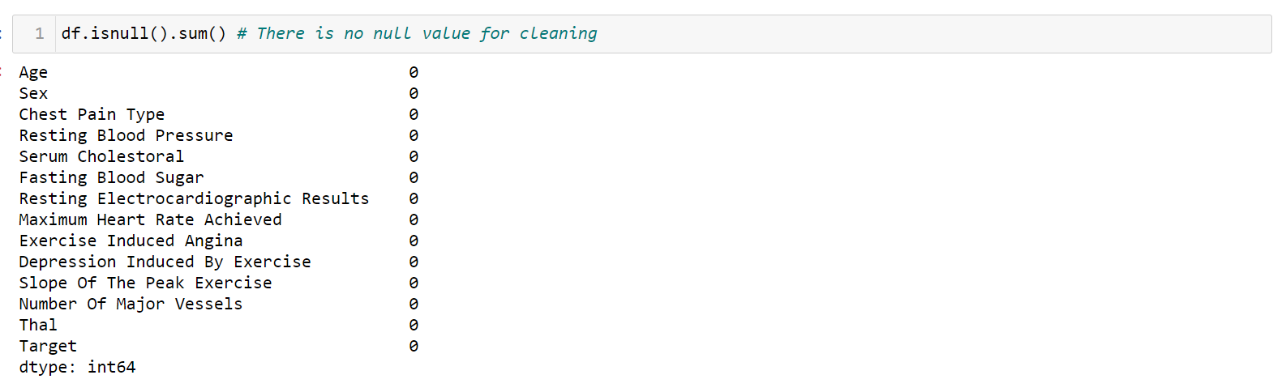
Data Cleaning
This is the most time tedious task. The data may have some duplicates, missing values or some error. Due to human error some values would be wrongly entered and stored in database. This type of data has to be cleaned before it is provided to model for training. But the data used for these project didn’t have any type of missing, mismatched, duplicate value as shown in below image

Slide 8
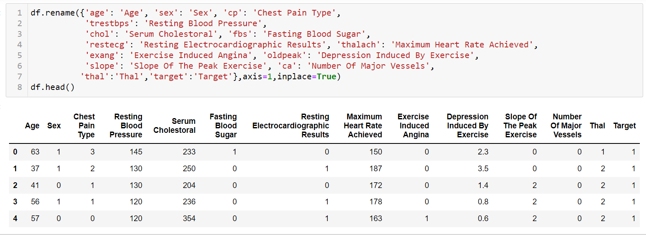
Data Transformation
Before going towards modelling the data, the dataset was firstly normalized and standardized. In the process of normalization, the input variables are normalized in the range between 0 and 1. In the process of standardization each input variable is scaled such that the mean value is subtracted from the input value and then the value thus obtained is divided by the standard deviation so that the distribution can be shifted such that the mean value can be obtained as 0 and the standard deviation value can be obtained as 1.But for these dataset only the renaming is done to understand it efficiently as shown.

Slide 9
Machine learning Algorithms Implemented
Logistics Regression
Naïve Bayes
K Nearest Neighbors
Decision Tree
Random Forest
Support Vector Machine
Adaptive Boosting

Slide 10
Classification Report of Algorithms Implemented
Algorithm | Accuracy | Precision | Recall | F1 - Score
Logistics Regression | 83.60 percent | 0 - 84 percent 1 – 83 percent | 0 -78 percent 1 -88 percent | 0 - 81 percent 1 – 86 percent
Decision Tree | 78.68 percent | 0 – 73 percent 1 – 84 percent | 0 – 81 percent 1 – 76 percent | 0 – 77 percent 1 - 80 percent
Random Forest | 88.52 percent | 0 – 86 percent 1 – 91 percent | 0 - 89 percent 1 – 88 percent | 0 – 87 percent 1 – 90 percent
Ada boost | 90.16 percent | 0 – 86 percent 1 – 94 percent | 0 – 93 percent 1 -88 percent | 0 – 89 percent 1 – 91 percent
Naïve bayes | 85.24 percent | 0 – 88 percent 1 – 84 percent | 0 -78 percent 1 – 91 percent | 0 – 82 percent 1 – 87 percent
K Neighbours | 85.24 percent | 0 -85 percent 1 -86 percent | 0 – 81 percent 1 – 88 percent | 0 – 83 percent 1 – 87 percent
Support Vector | 86.88 percent | 0 – 88 percent 1 -86 percent | 0 – 81 percent 1 - 91 percent | 0 – 85 percent 1 - 89 percent

Slide 11
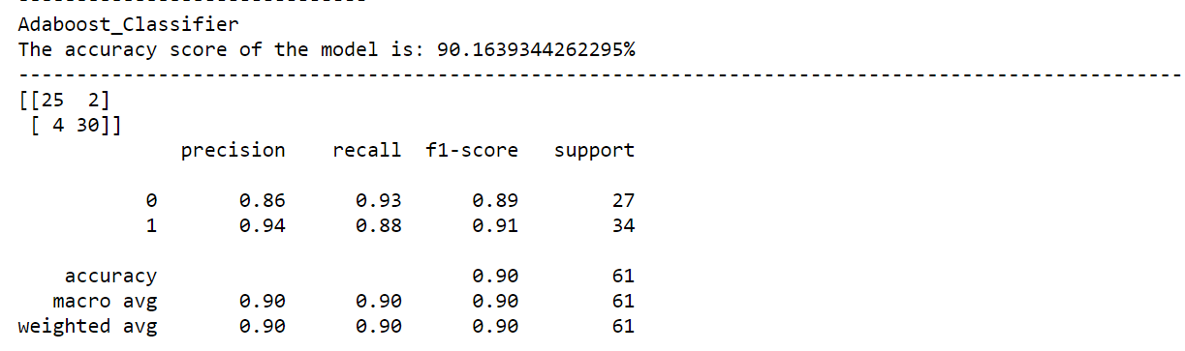
Model Selection
By implementing different algorithm, the classification report and accuracy on unseen dataset was quite good of Adaptive Boosting (Adaboost) as compared to others the output of the same is shown below

Slide 12
Conclusion
A prototype of the system which classifies an individual that he may suffer heart attack or not is implemented. The dataset was retrieved from Kaggle repository and pre-processed. The final dataset consists of 13 independent variables or features and one dependent variable named target . If target is 0, it implies that there is no chance heart attack and value of 1 implies that the person may suffer heart attack. For these classification, Adaboost algorithm has provided better accuracy and classification report compare to others.

Slide 13
Future Work
The similar prediction systems can be built for various other chronic or fatal diseases like Cancer, Diabetes, etc. with the help of recent technologies like machine learning, fuzzy logics, image processing and many others. Also, new algorithms can be proposed to achieve more accuracy and reliability. The Big Data Technology like Hadoop can be used to store huge chunks of data of all the users worldwide and to manage the data or reports of the user; technologies like Cloud Computing can be made use of.

Slide 14
Limitation Of This Research
The number of patient medical record was too less for training a accurate machine learning model.
The features taken into consideration for prediction of heart attack was only 14.
The guidance of domain experts such as cardiologist was not considered.
The accuracy and classification report was not up to the mark and can be improved using another technique.
The other important factors such as weight, resting heart rate, number of blood vessels blocked, smoker, alcoholic, etc.

Slide 15
THANK YOU

